Slide 1

09
Notes:
Mock-up for recreate Google I/O 2009 - The Myth of the Genius Programmer slides- Only for education purpose
1

Slide 2
Brian Fitzpatrick & Ben Collins-Sussman Mayo 2009
El mito del “Genio Programador”

Slide 3
¿Quiénes somos?

Slide 4
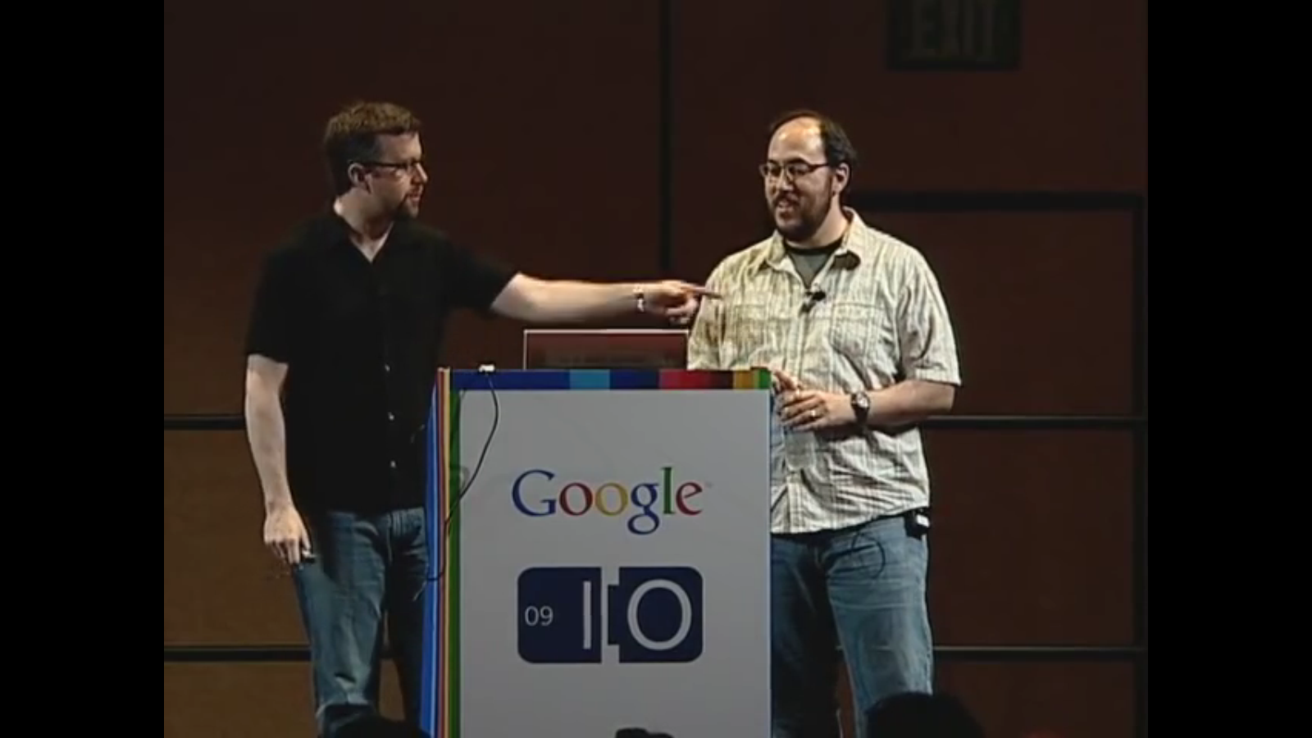
Brian Fitzpatrick
Ben Collins-Sussman

Slide 5
En palabras de Fiz y Ben:
Un par de geeks por largo tiempo del Control de Versiones
Trabajaron en Subversion hace unos años.
Con mucha experiencia en el mundo del Código Abierto.
Trabajaron en code.google.com (cuando aun era operativo)

Slide 6
“Can you guys please give Subversion on Google Code the ability to hide specific branches?”
Some Dude at Google I/O, 2008

Slide 7
“Can you guys make it possible to create open source projects that start out hidden to the world, then get ‘revealed’ when they’re ready?”
Some Other Dude at Google I/O, 2008

Slide 8
“Hi, I want to rewrite all my code from scratch, can you please wipe all the history?”
Some Guy on our mailing list

Slide 9
Can you spot the theme?

Slide 10
Insecurity

Slide 11
The Genius Myth

Slide 12
“There’s a pervasive elitism at work in the programming community. Add anonymity to the mix, and everyone is suddenly elite.”
Kyle K (Commenting on Ben’s Blog)

Slide 13
There is no genius.

Slide 14
“You are not a beautiful or unique snowflake.
You’re the same decaying organic matter as everything else.”
Tyler Durden, Fight Club

Slide 15
Avoiding the trap

Slide 16
Lose the Ego

Slide 17
Criticism is not evil

Slide 18
Embrace failure

Slide 19
Practice is key

Slide 20
Be a Small Fish

Slide 21
Be Influenced

Slide 22
Be Vulnerable

Slide 23
“You cannot apply a technological solution to a sociological problem…”
Internet Adage

Slide 24
..but default behaviors matter a lot.

Slide 26
Where sould the third milestone go?

Slide 27
Too early

Slide 28
Sweet Spot!

Slide 29
Case Study: Subversion

Slide 30
Case Study: Ben & Fitz

Slide 31
Obligatory Summary Slide
Don’t try to be a genius
Collaborate early and often
Pay attention to your tools
Pay attetion to timing

Slide 32
But here’s the secret…

Slide 33
…if you do all these things

Slide 34
People Will Think You’re a Genius

Slide 35
09
Notes:
Mock-up for recreate Google I/O 2009 - The Myth of the Genius Programmer slides- Only for education purpose
35

